Slide 1
Rockbuster Business Managers
Project: To find the top five Rockbuster customers in the top ten countries.
Purpose 1: Management team wants to know which top ten countries where customers are base to focus on better brand image in those markets.
Purpose 2: Customer team wants to reward top five customers for their loyalty.

Slide 2
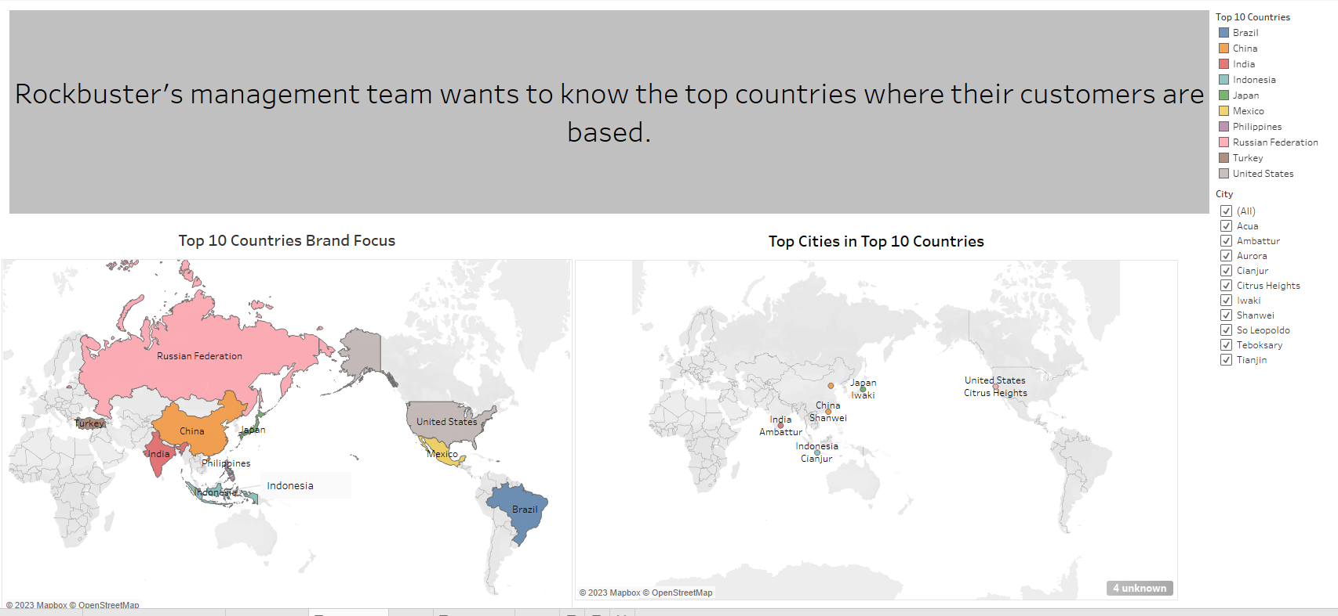
Rockbuster Business Managers

Slide 3
Rockbuster Business Managers
Key KPI Statistics
min_rental_duration | max_rental_duration | avg_rental_duration | min_rental_rate | max_rental_rate | avg_rental_rate
3 Days | 7 | 4.985 | 0.99 | 4.99 | 2.98
min_length | max_length | avg_length | min_replacement_cost | max_replacement_cost | avg_replacement_cost
46 Minutes | 185 Minutes | 115.272 Minutes | $9.99 | $29.99 | $19.984
modal_value or most frequent film rating
PG-13

Slide 4
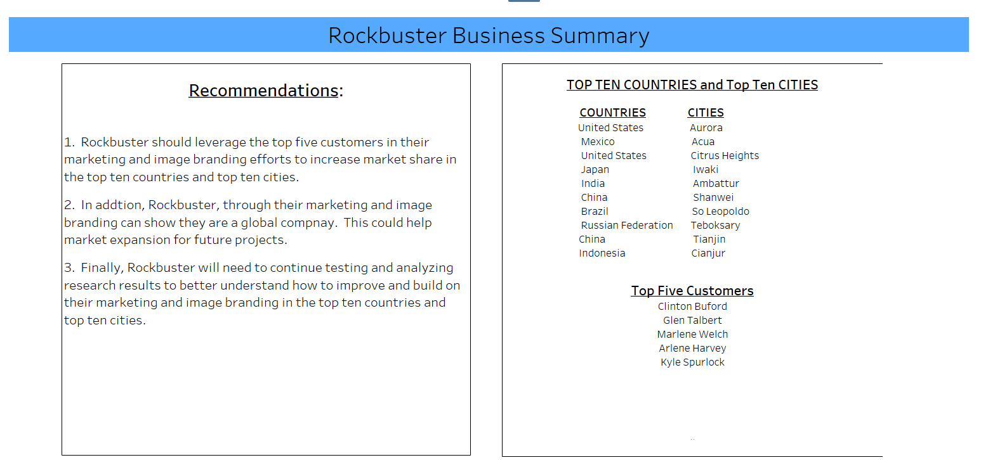
Rockbuster Business Managers

Slide 5
Rockbuster Business Managers
Tableau Links
Link for top 10 countries and cities
https://public.tableau.com/app/profile/rich.bradley/viz/3_10Step1_A/Dashboard1?publish=yes#WelcomeQuestionnaire
Link for recommendations
https://public.tableau.com/app/profile/rich.bradley/viz/3_10Step1_final/Dashboard2?publish=yes

